Slide 1

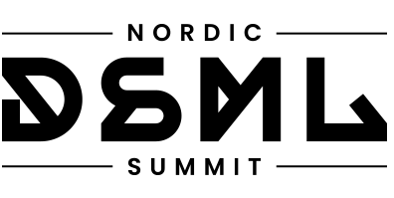


EFFECTIVE LAKEHOUSE STREAMING
With Delta Lake & Friends
Scott Haines
Distinguished Software Engineer, Nike 10/24/2024

Slide 2
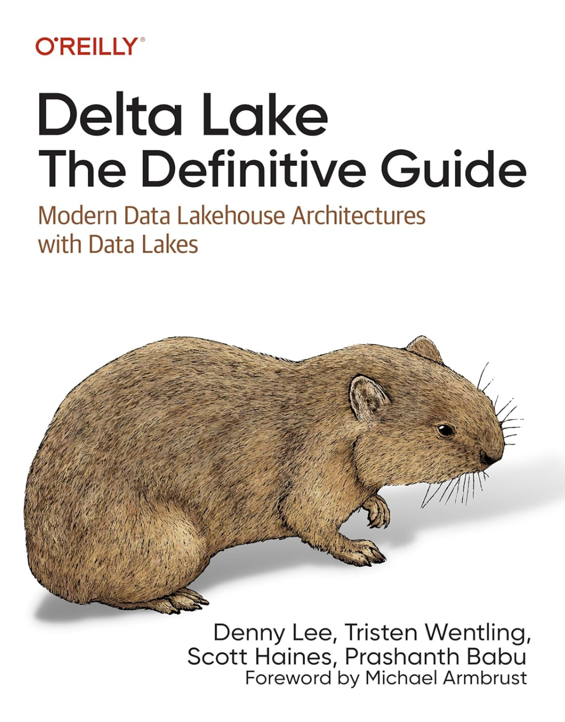
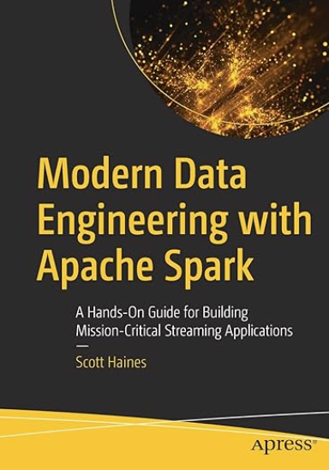

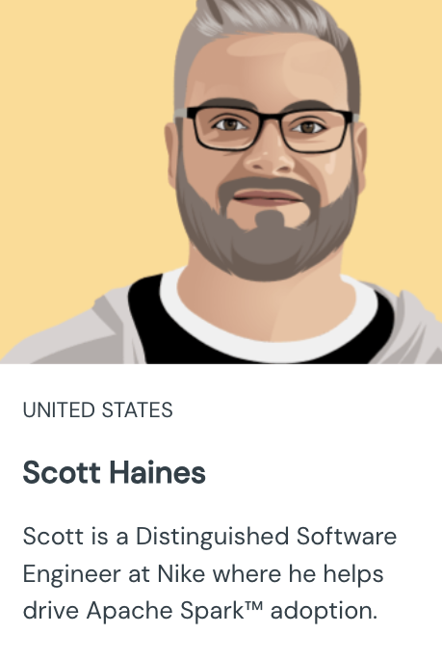

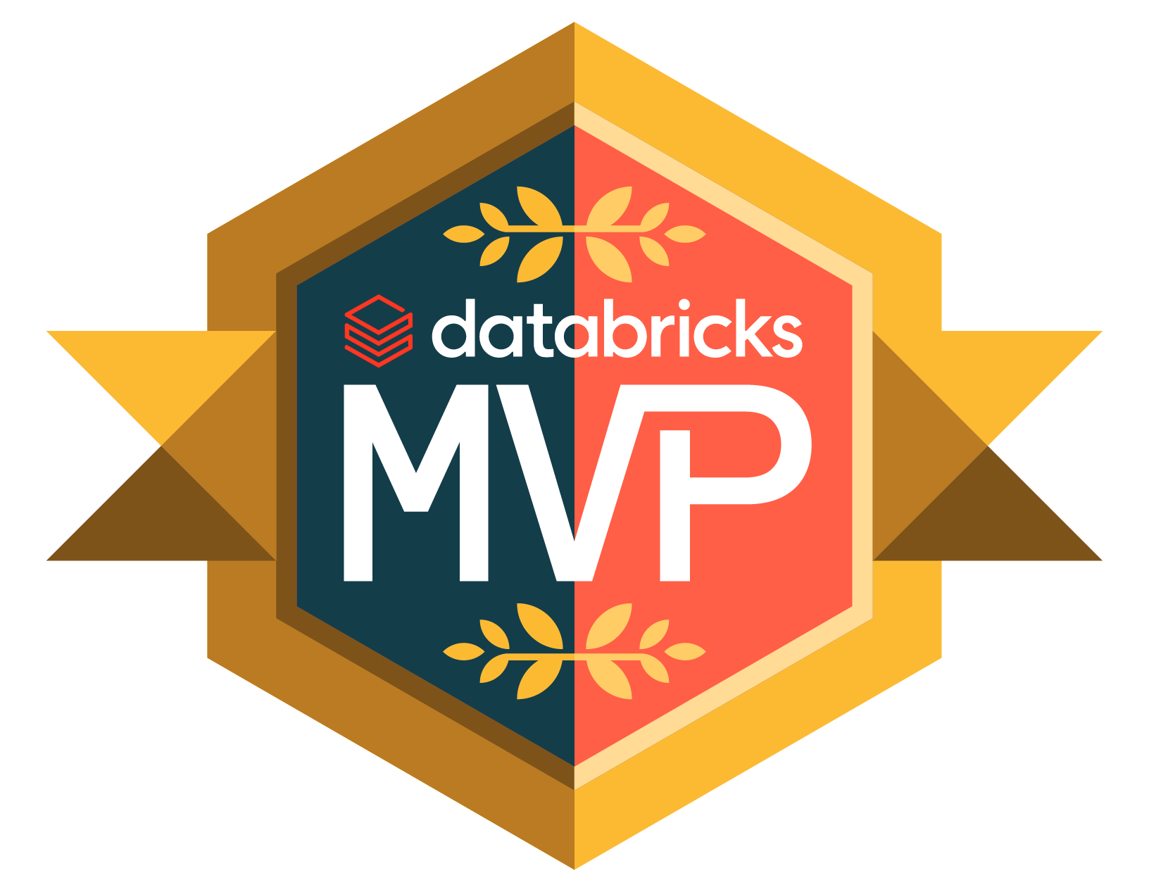
Introduction
Speaker(name=‘Scott’).be(‘social’).execute()
Scott Haines
Engineer (loves to code)
Author (loves to write)
Databricks MVP (Beacons) (since 2020)
Teacher / Mentor
Notes:
Introduction: 2 minutes max

Slide 3
Preparing for our Journey
Towards Effective Lakehouse Streaming
Part 1: What are Protocol Streams?
Part 2: Design Patterns: Streaming Medallion Architecture
Part 3: Engineering End-to-End Trust Networks
Notes:
What we will learn: 2-3 minutes (max)
Design patterns have been at the heart of computer science and at the for-front of critical forks in the computational road(s) — without learning from the wisdom of the crowds and taking advantage of all the prior lessons learned (the hard way), we’d all suffer just a little bit more. Remember we are blessed to stand on the shoulders of giants.
As we’ve progressed, our applications and services have all acquired an insatiable appetite for data. While we are hungry for data, there is a difference that is worth remembering between good data, and the kind of data that spoils our appetites. Together we’ll unravel the building blocks for an effective streaming architecture for the Lakehouse, and learn the following:

Slide 4
Shifting from Batch-Oriented to Streaming-First requires a paradigm shift for our Mental Models (and for our applications).
Notes:
For those of you who are currently already working with unbounded streams of data, this might come across as a simple observation. However, for those who are just stepping into the uncharted waters of streaming, getting started can be tricky.
Why do most batch jobs fail? (is it the volume of data? Is it the validity of the structured data? Is it the complexities of managing state?)
From my experience, the biggest problems tend to exist within the layout of the ingested data (what are we consuming)
This is where protocol streams come into play. Let’s look at them next!

Slide 5

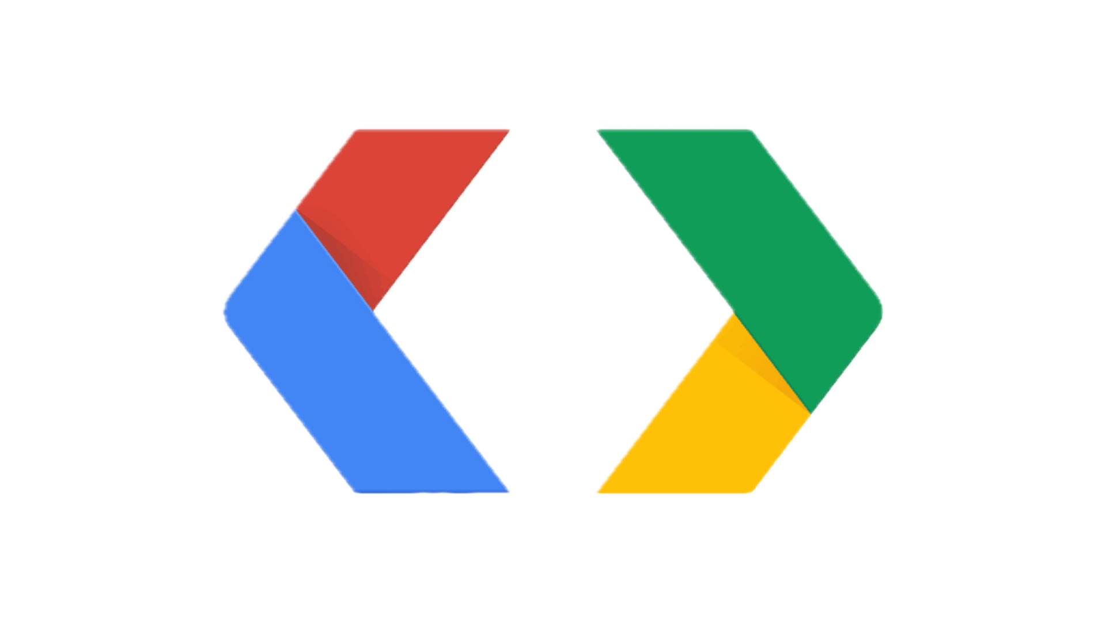
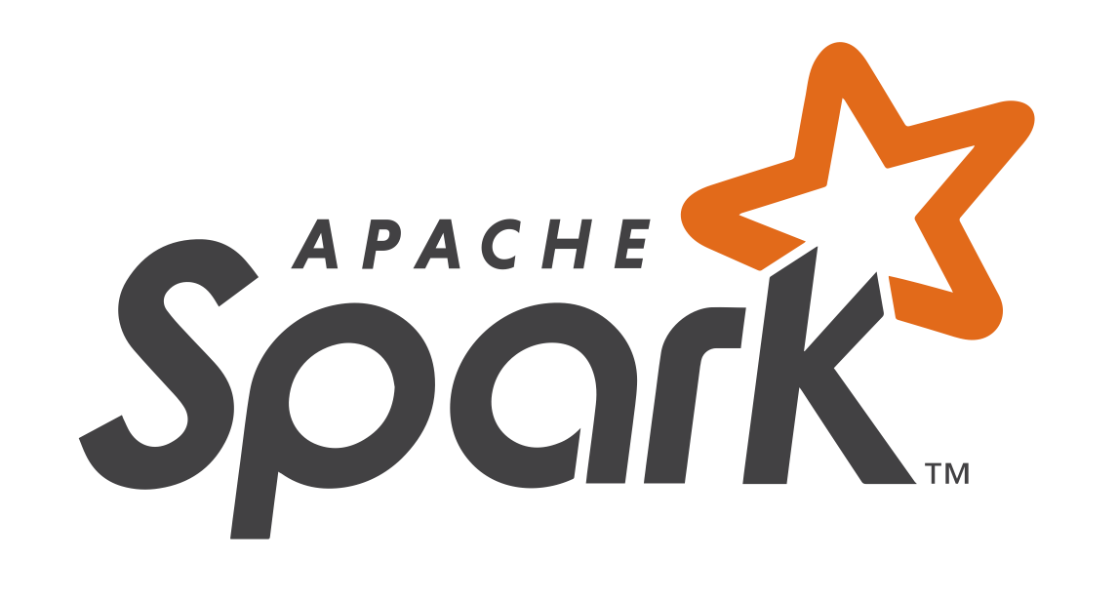
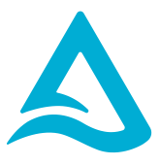
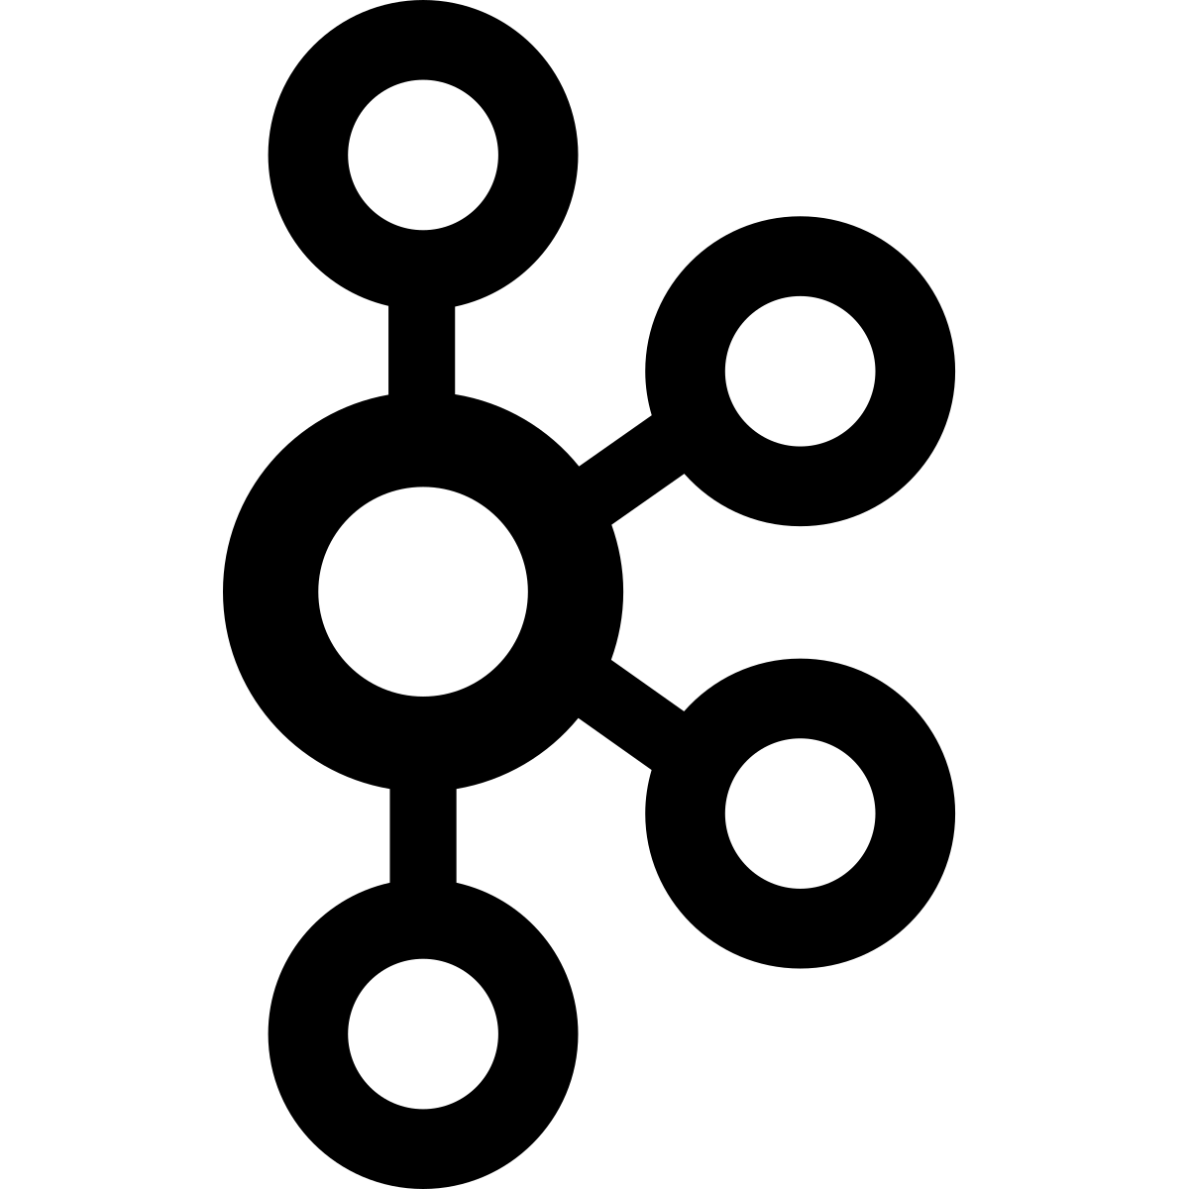
Ingestion Architecture
Foundational Trust by Design
Client
Topic A
Gateway API Service
Generic Data App
Streaming Table A
Client
Client
Generic Data App
Streaming Table N
Client
Edge-Validation
Topic N
Notes:
Overview of the Journey: (2-5 minutes)

Slide 6
Towards Reliable Streaming
What are Protocol Streams?
Protocol:
“A System of Rules that Explain the Correct Conduct and Procedures to be Followed…”
Protocol Streams provide consistent data quality in flight. Utilizing “gRPC”, our friend ”protobuf”, and the “protovalidate” library from Buf.
{
Streams:
“A Continuous, or Pseudo-Continuous Flow of Unbounded Data”
https://github.com/bufbuild/protovalidate
Notes:
Protocol + Stream
- Introduction to Protobuf + Buf + Buf Connect
Introduction to Protovalidate for in-flight data validations at the Edge.
Mental Models and Ways of Working (buf breaking…)
Type-Safe, Consistent Structured Data
How to Utilize Protocol Buffers (aka “protobuf”) for an Unbreakable Data Foundation: How to model consistent and composable serializable structured data to encapsulate entities within our Data Domains through the concept of Messages.
Building Reliable Ingestion Services with gRPC (w/ Buf Connect) and Edge-Level Validation (w/ ProtoValidate): How to successfully build data-dominant ingestion services that include painless field-level validations, that can scale easily, and support the variable requirements for any stage in the lifecycle of any company. (could just talk about protobuf + protovalidate -> hand wave through the connect wizardry (time))
Using Protocol-Streams to Standardize and Simplify ingestion into our internal Data Domains. Apache Kafka, Pulsar, and other distributed message brokers enable distributed data brokerage services utilizing the validated foundational Data Streams emitted from our Ingestion Services. [ share the tin layer (see later) pattern, to aggressively transport our data from (anything else) -> Delta table. Provided that we utilize smart practices when it comes to releasing backwards (non-breaking) changes to the protocol-streams this provides the best foundation for any and all work to begin within the Streaming Lakehouse -> let’s learn about the Streaming Medallion Architecture.

Slide 7
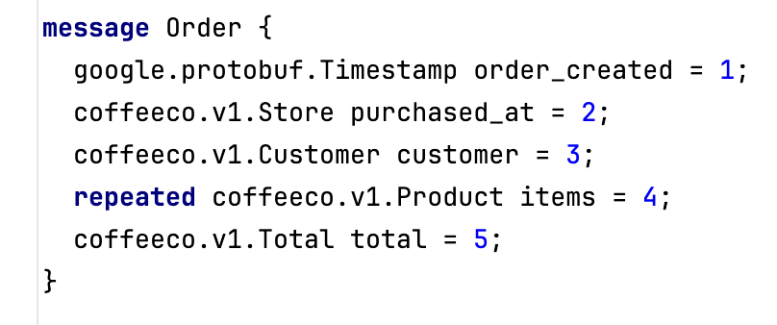
Towards Reliable Streaming
Working Backwards from the Data
Protobuf: Provides Binary Serializable Structured Data. It’s type-safe, and language agnostic.
* Protobuf is also Backwards and Forwards Compatible! * Spark 3.4 introduced native support for protobuf.
Notes:
Protocol + Stream
- Introduction to Protobuf + Buf + Buf Connect
Introduction to Protovalidate for in-flight data validations at the Edge.
Mental Models and Ways of Working (buf breaking…)
How to Utilize Protocol Buffers (aka “protobuf”) for an Unbreakable Data Foundation: How to model consistent and composable serializable structured data to encapsulate entities within our Data Domains through the concept of Messages.
Building Reliable Ingestion Services with gRPC (w/ Buf Connect) and Edge-Level Validation (w/ ProtoValidate): How to successfully build data-dominant ingestion services that include painless field-level validations, that can scale easily, and support the variable requirements for any stage in the lifecycle of any company. (could just talk about protobuf + protovalidate -> hand wave through the connect wizardry (time))
Using Protocol-Streams to Standardize and Simplify ingestion into our internal Data Domains. Apache Kafka, Pulsar, and other distributed message brokers enable distributed data brokerage services utilizing the validated foundational Data Streams emitted from our Ingestion Services. [ share the tin layer (see later) pattern, to aggressively transport our data from (anything else) -> Delta table. Provided that we utilize smart practices when it comes to releasing backwards (non-breaking) changes to the protocol-streams this provides the best foundation for any and all work to begin within the Streaming Lakehouse -> let’s learn about the Streaming Medallion Architecture.

Slide 8
Protobuf is type-safe, which provides consistent structured data. It doesn’t however provide field-level consistency out of the box…
Notes:
This is where the protovalidate library comes into play…

Slide 9
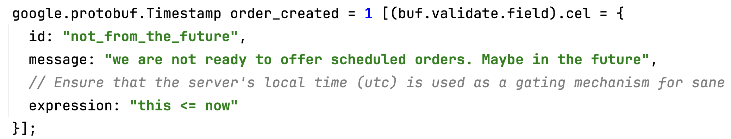
Towards Reliable Streaming
Ensuring the Data is Captured in the Correct State
Protovalidate: Provides the missing piece of the protobuf-pie by Bringing field-level validation rules, including conditional expressions utilizing Google CEL (common expression language).
^ prevents bad timestamps from breaking timeseries
https://github.com/google/cel-spec
Notes:
Protocol + Stream
- Introduction to Protobuf + Buf + Buf Connect
Introduction to Protovalidate for in-flight data validations at the Edge.
Mental Models and Ways of Working (buf breaking…)
How to Utilize Protocol Buffers (aka “protobuf”) for an Unbreakable Data Foundation: How to model consistent and composable serializable structured data to encapsulate entities within our Data Domains through the concept of Messages.
Building Reliable Ingestion Services with gRPC (w/ Buf Connect) and Edge-Level Validation (w/ ProtoValidate): How to successfully build data-dominant ingestion services that include painless field-level validations, that can scale easily, and support the variable requirements for any stage in the lifecycle of any company. (could just talk about protobuf + protovalidate -> hand wave through the connect wizardry (time))
Using Protocol-Streams to Standardize and Simplify ingestion into our internal Data Domains. Apache Kafka, Pulsar, and other distributed message brokers enable distributed data brokerage services utilizing the validated foundational Data Streams emitted from our Ingestion Services. [ share the tin layer (see later) pattern, to aggressively transport our data from (anything else) -> Delta table. Provided that we utilize smart practices when it comes to releasing backwards (non-breaking) changes to the protocol-streams this provides the best foundation for any and all work to begin within the Streaming Lakehouse -> let’s learn about the Streaming Medallion Architecture.

Slide 10
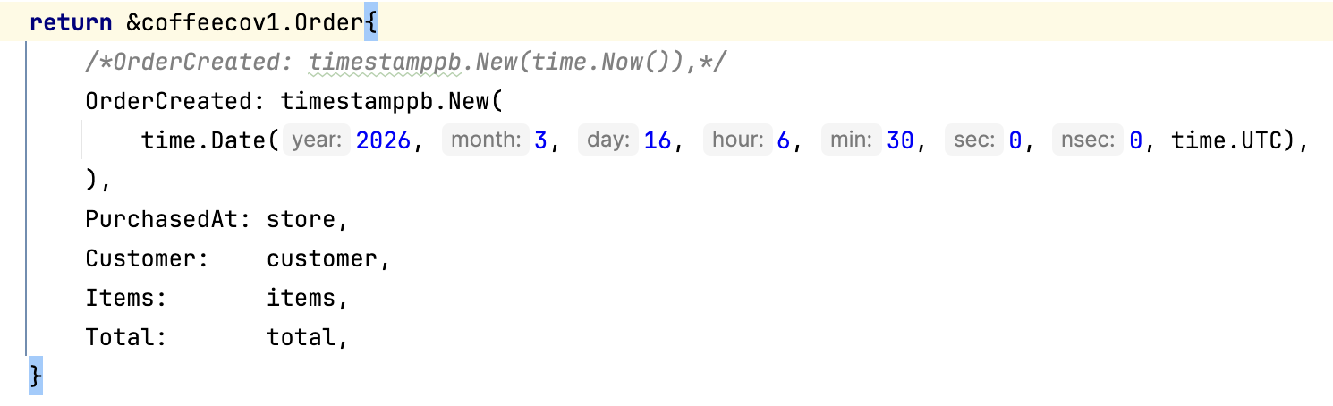
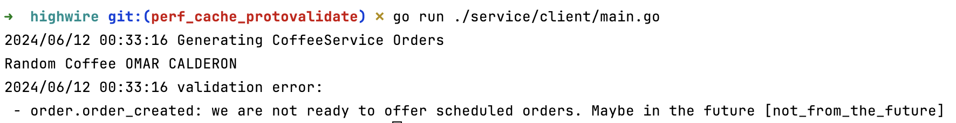
Towards Reliable Streaming
Edge-Level Validations: Protect your Data Ingestion Network
<- For Sake of Example!
(time-traveling event)
Notes:
Failing-Fast at the Edge prevents bad (incorrect) data from flowing into Kafka (or whatever stream processing framework you are using)
- It is easier to fix the applications emitting incorrect data than it is to retroactively fix problems with data once it has landed

Slide 11
What does it take to build a reliable ingestion platform?
Notes:
- So this must be hard to do right? Well, actually it isn’t as difficult as you may think!

Slide 12

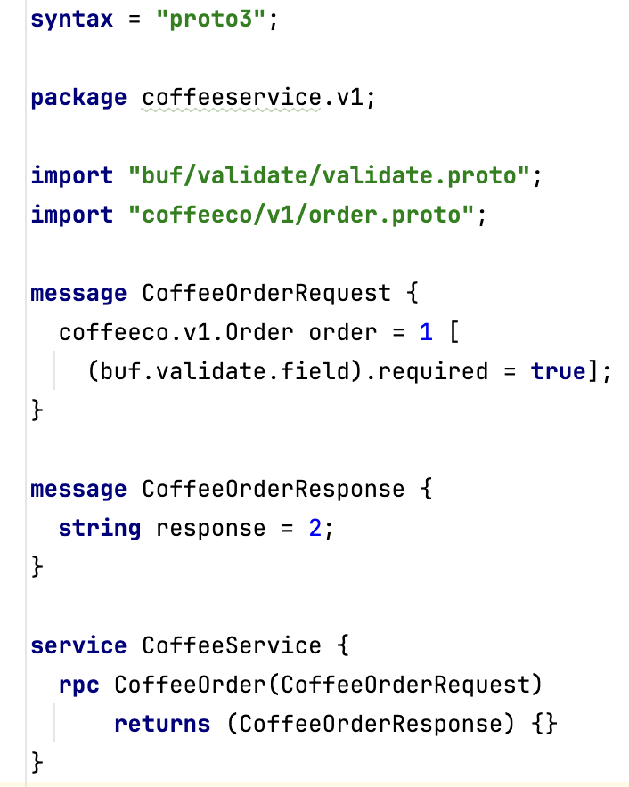
Buf Connect Service
Enabling Simplified gRPC over HTTP/2
Interface Driven:
The Protobuf is the Data Contract
Our Service Definition (IDL) provides ”exactness” guarantees
Provides linting, formatting, as well as breaking-change detection using the buf cli.
% buf lint && buf format –w && buf generate
% buf breaking –against .git#branch=origin/main
Notes:
Buf and ConnectRPC
Buf provides tooling to simplify using Protobuf within you organization
ConnectRPC is an opinionated variant of gRPC (fully interoperable) that provides idiomatic compilers for most languages
This enables http or http/2 transport using native grpc or transformations from traditional rest-like http to make gRPC easy to support on the web as it is within the server-side environment

Slide 13

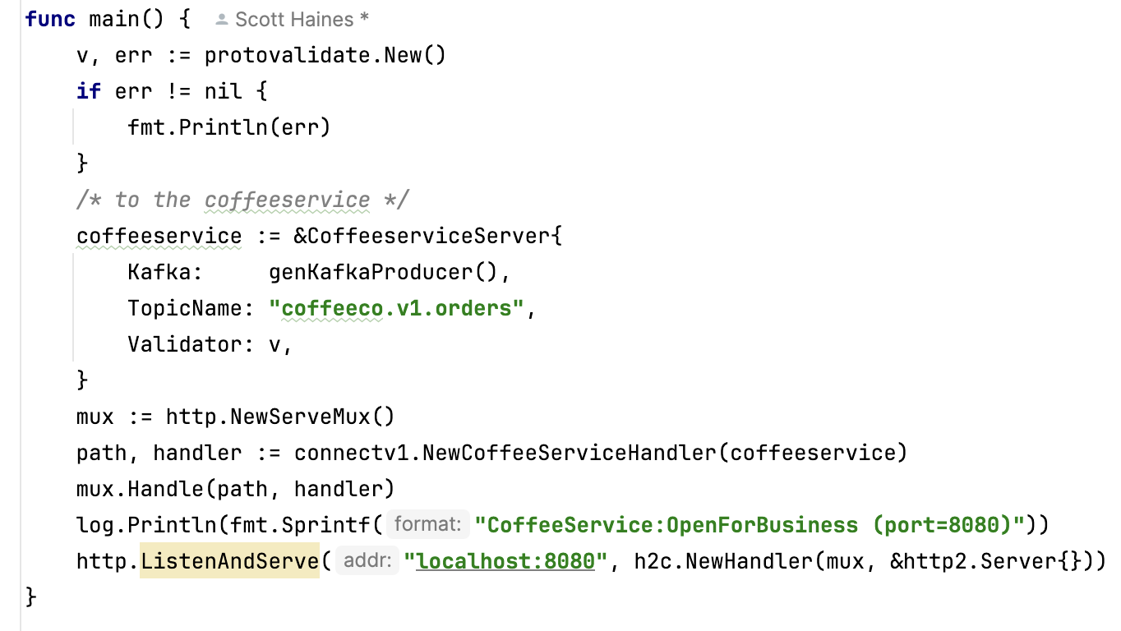
Buf Connect Service
Server-Side Service Implementation
Implement the Service:
Using Code-Generation, a fully validated gateway service is <100 lines of Go
https://bit.ly/dais-highwire
Notes:
Using the Interface defined in the prior slide, we call `buf generate` to scaffold a majority of the server-side and client-side.
You essentially bring your business-logic to the table and connectRPC takes care of the rest
Simplifies building reliable ingestion services.

Slide 14
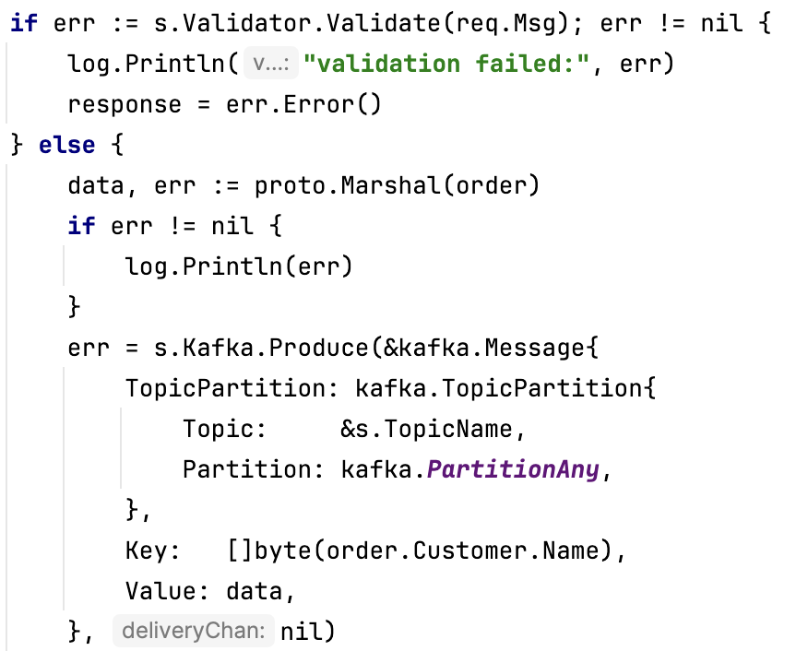
Buf Connect Service
Consistent Edge-Level Validations
Invoke the Validator:
Validations are generated during Code Generation
Invoke by passing a Protobuf Message
https://bit.ly/dais-highwire
Notes:
What does edge-level validation look like?

Slide 15
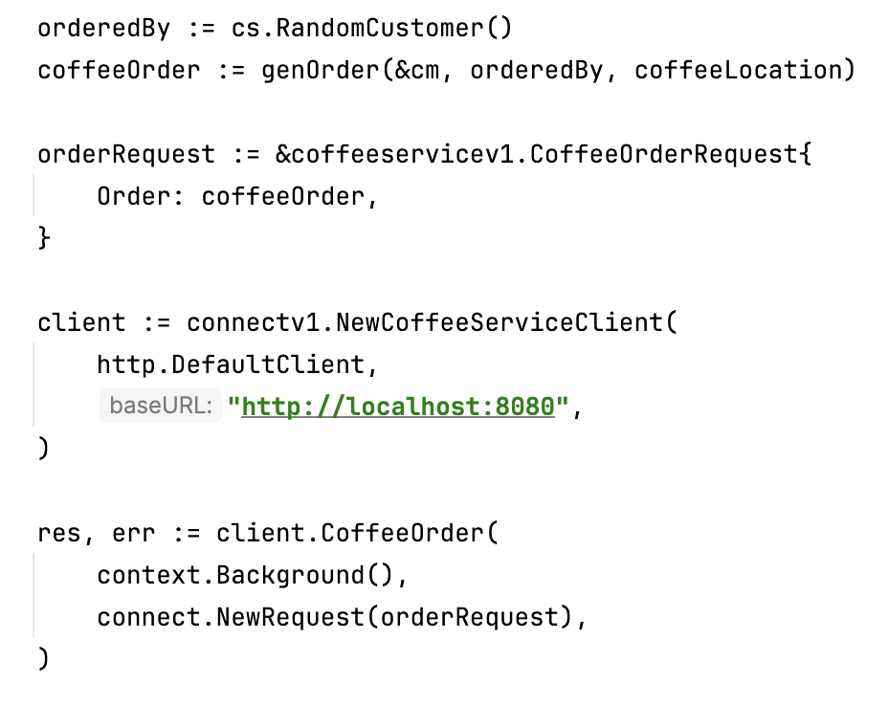
Buf Connect Service
Client-Side Implementation
Interface Driven:
The Protobuf is the Data Contract
Our only concern is sending valid protobuf from the client
Notes:
Building out the client-side from the generated SDK code.

Slide 16
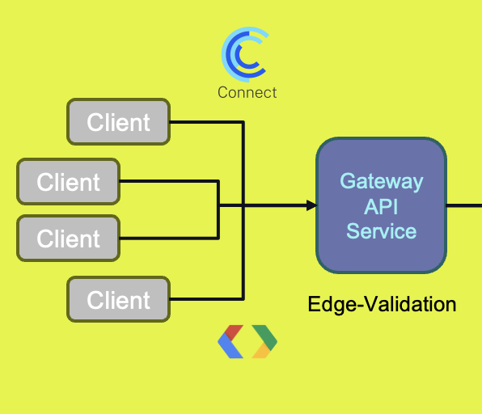
Consistent Data Ingestion
Via Protocol Streams: Recap (High-Trust by Design)
Protobuf with Protovalidate enable High-Trust Ingestion Networks
Utilizing ConnectRPC (CNCF) simplifies gRPC
Code-Generation makes Ingestion Easy-Breezy
Simplifies Engineering Coordination for Mission-Critical Data Ingestion
Notes:
This pattern provides highly consistent data ingestion services that pave the way for high-trust data processing.

Slide 17
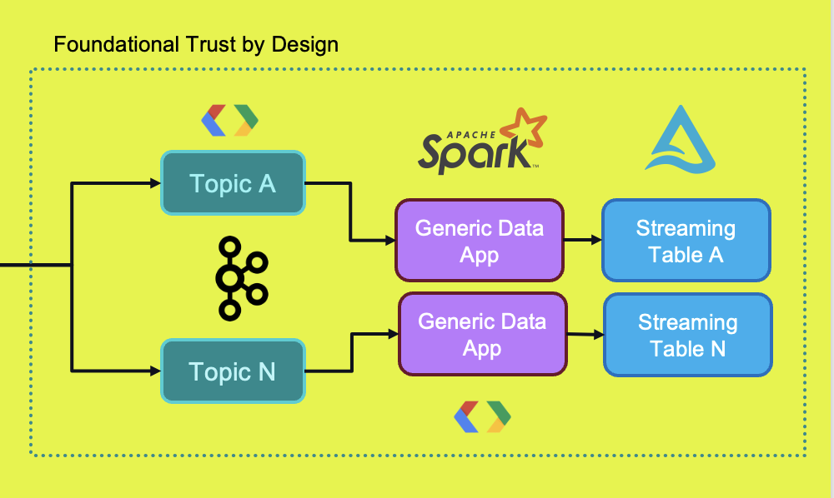
The Protocol Streams pattern greatly simplify initial ingestion into the Lakehouse
Notes:
Using the protobuf data from our Kafka topics is super simple.

Slide 18
Lakehouse Design Patterns
Automatic (Generic) Ingestion to the “Tin” Layer
Config-Driven Applications
Produce Stable Foundational Delta Tables

Slide 19
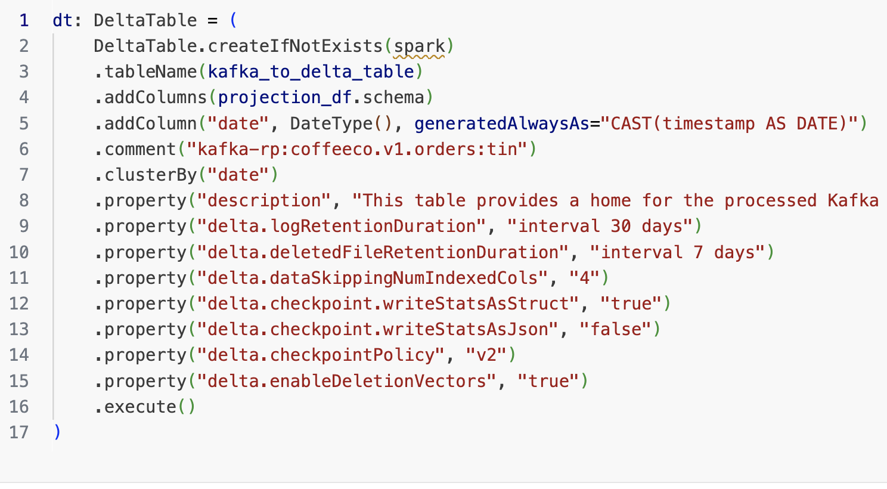
Tin-Layer Pattern: Medallion
Automating Ingestion from Kafka to Tin
Simplicity at the Tin-Layer: The purpose of the table is to reliably store our binary protobuf.
Removes the trouble with time with streaming ingestion from Kafka.
Automatically generates and clusters by date.
Provides a Landing-Zone within your Internal Data Domain
Notes:
The Tin-Layer Pattern
Tin is essentially a landing-zone pattern.
We are focused on reading data from Kafka and writing it Delta using an ”append-only” approach.

Slide 20
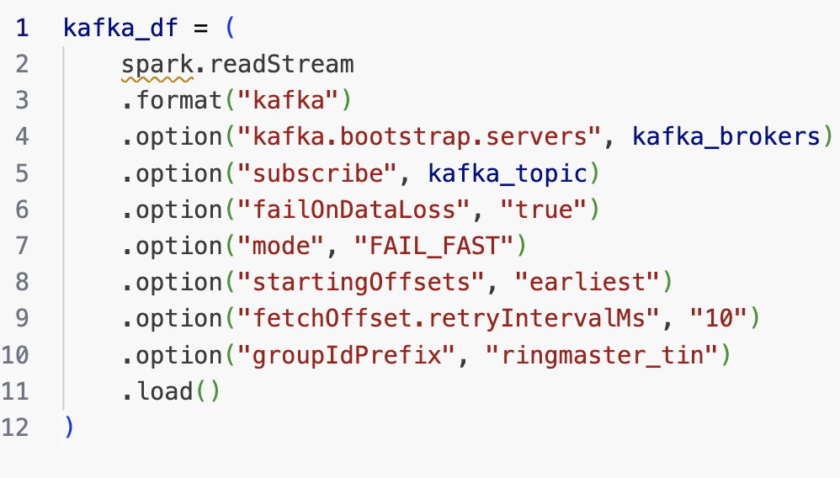
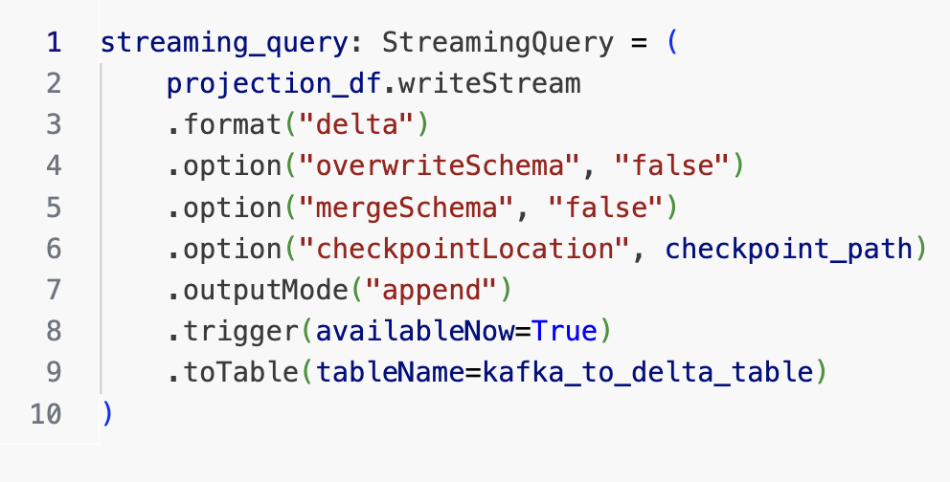
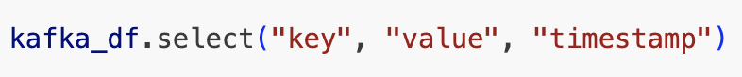
Tin-Layer Pattern: Medallion
Automating Generic Ingestion from Kafka to Tin
Notes:
Nothing about this pattern requires heavy-lifting. It can be completely configuration-driven.

Slide 21
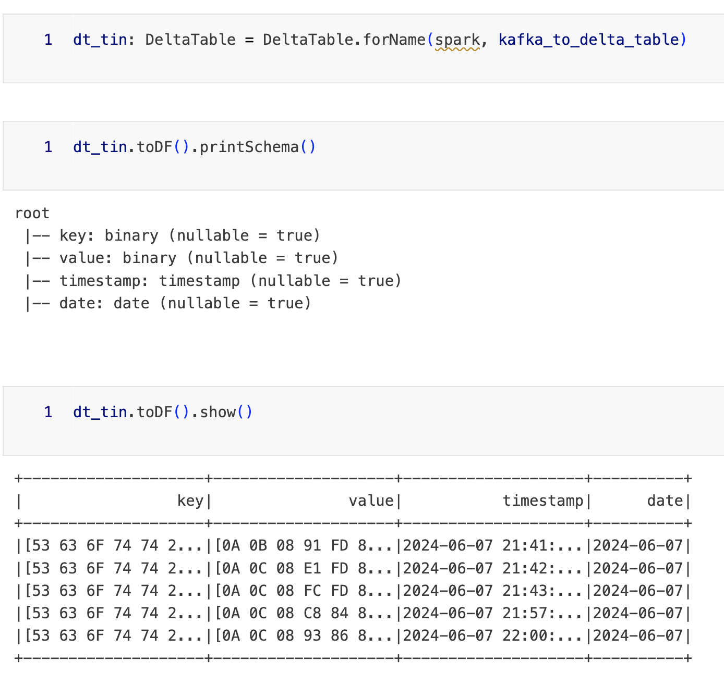
Tin-Layer Pattern: Medallion
Reliable Landing Zone Pattern
End Results: The Validated, Consistent Protobuf Data is now living happily in our Delta table.
This means we can reprocess without requiring round-trips to the Kafka brokers
Many downstream jobs “can” read from the same foundational table without requiring access to your Kafka Brokers.
Follows the single-source-of-data truth pattern
Edge-Validated Protobuf Bytes
Notes:
Protocol + Stream
- Introduction to Protobuf + Buf + Buf Connect
Introduction to Protovalidate for in-flight data validations at the Edge.
Mental Models and Ways of Working (buf breaking…)
How to Utilize Protocol Buffers (aka “protobuf”) for an Unbreakable Data Foundation: How to model consistent and composable serializable structured data to encapsulate entities within our Data Domains through the concept of Messages.
Building Reliable Ingestion Services with gRPC (w/ Buf Connect) and Edge-Level Validation (w/ ProtoValidate): How to successfully build data-dominant ingestion services that include painless field-level validations, that can scale easily, and support the variable requirements for any stage in the lifecycle of any company. (could just talk about protobuf + protovalidate -> hand wave through the connect wizardry (time))
Using Protocol-Streams to Standardize and Simplify ingestion into our internal Data Domains. Apache Kafka, Pulsar, and other distributed message brokers enable distributed data brokerage services utilizing the validated foundational Data Streams emitted from our Ingestion Services. [ share the tin layer (see later) pattern, to aggressively transport our data from (anything else) -> Delta table. Provided that we utilize smart practices when it comes to releasing backwards (non-breaking) changes to the protocol-streams this provides the best foundation for any and all work to begin within the Streaming Lakehouse -> let’s learn about the Streaming Medallion Architecture.
Goals
Config-Driven
Do less but pop up…
Can segue into Brickflow to talk about orchestrating…

Slide 22
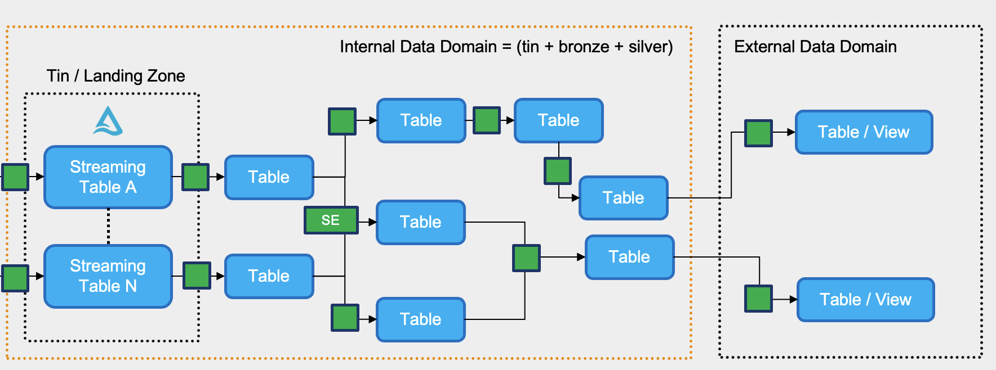
Connecting the Streaming Dots
Notes:
Lastly, we are going to look at the Streaming Medallion Architecture pattern.

Slide 23

Streaming Medallion Architecture
Design Patterns and Use Cases
What We’ll Learn
How Internal & External Data Domains improve the Medallion Architecture
From Tin-X: Protobuf Extraction Design Pattern.
Consistent Aggregations with Spark-Expectations
Medallion and Streaming Medallion are covered here ^
Notes:
Section: ~5-7 minutes
Streaming Medallion Architectural Patterns: Effectively utilizing landing-zones (tin-layer), as well as internal (bronze/silver) and external data domains (gold). We will introduce the “Docker Filesystem Model for Composable Data”, as well as patterns for efficiently “insulating” data consumers from the inner workings and operations nestled in the “internal data domain”, so they can rest assured that their “fit-for-purpose” data is always available “as-expected” when it comes time to access data in the “external data domain”. Analogies to effective API design — and the facade-pattern for data. [Opportunity to interlace and introduce spark-expectations] — how it fits into the effective streaming model — tip of the hat to Delta etc etc.
Must Cover: Tin (Optional Layer) — to remove the “pressure” when it comes to data flow. Drop it into a Delta Table (tin: <timestamp, key, value, [additional-metadata_or_headers])
show the generateAlwaysAs(“timestamp”) pattern
show the “steal the schema” pattern for building Delta Tables (fromSchema(df.schema))….
Use Case: Coffee Empire…
Lineage (is trust-network) – same idea
Introduction to Internal & External Data Domains
Docker File System for Data Design pattern
(composable, single-sources-of-data truth)
Internal and External Concerns

Slide 24
Triggering Patterns
How to use Triggers Efficiently
Triggers help you solve the streaming goldilocks problem.
Stateful Batch
df.writeStream
.format("delta")
…
.outputMode("append")
.trigger(once=True)
.toTable(…)
df.writeStream
.format("delta")
…
.outputMode("append")
.trigger(availableNow=True)
.toTable(…)
df.writeStream
.format("delta")
…
.outputMode("append")
.trigger(processingTime=‘30 seconds’)
.toTable(…)
Runs one complete batch. No throttling. Can cause OOMs.
Notes:
Goals:
Utilizing the Valid Data Flowing into Kafka, we must only concern ourselves with

Slide 25
Triggering Patterns
How to use Triggers Efficiently
Triggers help you solve the streaming goldilocks problem.
Auto-Terminating Streaming Micro-Batch
df.writeStream
.format("delta")
…
.outputMode("append")
.trigger(once=True)
.toTable(…)
df.writeStream
.format("delta")
…
.outputMode("append")
.trigger(availableNow=True)
.toTable(…)
df.writeStream
.format("delta")
…
.outputMode("append")
.trigger(processingTime=‘30 seconds’)
.toTable(…)
Supports throttling.
Notes:
Goals:
Utilizing the Valid Data Flowing into Kafka, we must only concern ourselves with

Slide 26
Triggering Patterns
How to use Triggers Efficiently
Triggers help you solve the streaming goldilocks problem.
Streaming Micro-Batch
df.writeStream
.format("delta")
…
.outputMode("append")
.trigger(once=True)
.toTable(…)
df.writeStream
.format("delta")
…
.outputMode("append")
.trigger(availableNow=True)
.toTable(…)
df.writeStream
.format("delta")
…
.outputMode("append")
.trigger(processingTime=‘30 seconds’)
.toTable(…)
Supports throttling.
Notes:
Goals:
Utilizing the Valid Data Flowing into Kafka, we must only concern ourselves with

Slide 27
Streaming Medallion Architecture
Internal Data Domain = (tin + bronze + silver)
External Data Domain
Tin / Landing Zone
Table
Table
Table / View
Streaming Table A
Table
Table
Table
Streaming Table N
Table
Table
Table / View
Table
Bronze + Silver Layers
Gold Layer
Data Application or Process
Notes:
Overview of the Journey: (2-5 minutes)
Add SE for spark-expectations and then get into that for the trust-networks.
“Trust Networks” – this is the big takeaway

Slide 28
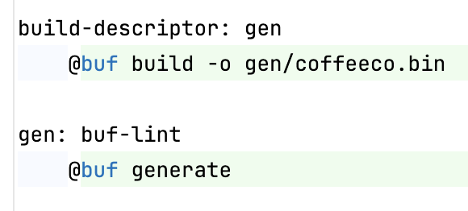
From Tin->X Pattern: Medallion
Reliable Extraction using Protobuf Descriptors
Using Native Protobuf with Spark:
Requires a Protobuf Descriptor.
“The term descriptors refers to models that describe the data types defined in Protobuf sources. They resemble an AST (Abstract Syntax Tree) of the Protobuf IDL, using Protobuf messages for the tree nodes.”
% make build-descriptor
{
coffeeco.bin
https://buf.build/docs/reference/descriptors
Notes:
Goals:
Utilizing the Valid Data Flowing into Kafka, we must only concern ourselves with

Slide 29

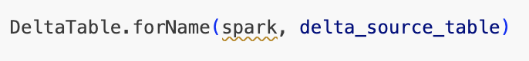
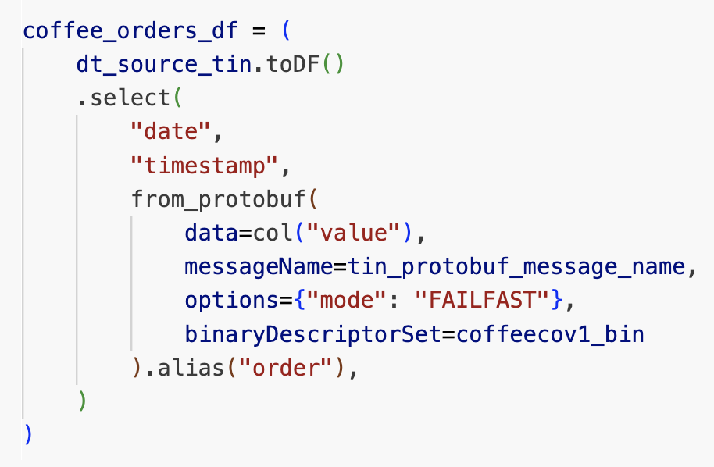
From Tin-X Pattern: Medallion
Simplified Transformations using Protobuf Descriptors
Using Native Protobuf with Spark:
Create a Delta Table reference to the Tin Table
Load the Binary Descriptor
Decode from Binary Blob (value)
Converts to a Catalyst Tree (DataFrame)
Notes:
Protocol + Stream
- Introduction to Protobuf + Buf + Buf Connect
Introduction to Protovalidate for in-flight data validations at the Edge.
Mental Models and Ways of Working (buf breaking…)
How to Utilize Protocol Buffers (aka “protobuf”) for an Unbreakable Data Foundation: How to model consistent and composable serializable structured data to encapsulate entities within our Data Domains through the concept of Messages.
Building Reliable Ingestion Services with gRPC (w/ Buf Connect) and Edge-Level Validation (w/ ProtoValidate): How to successfully build data-dominant ingestion services that include painless field-level validations, that can scale easily, and support the variable requirements for any stage in the lifecycle of any company. (could just talk about protobuf + protovalidate -> hand wave through the connect wizardry (time))
Using Protocol-Streams to Standardize and Simplify ingestion into our internal Data Domains. Apache Kafka, Pulsar, and other distributed message brokers enable distributed data brokerage services utilizing the validated foundational Data Streams emitted from our Ingestion Services. [ share the tin layer (see later) pattern, to aggressively transport our data from (anything else) -> Delta table. Provided that we utilize smart practices when it comes to releasing backwards (non-breaking) changes to the protocol-streams this provides the best foundation for any and all work to begin within the Streaming Lakehouse -> let’s learn about the Streaming Medallion Architecture.
Goals
Config-Driven
Do less but pop up…
Can segue into Brickflow to talk about orchestrating…

Slide 30
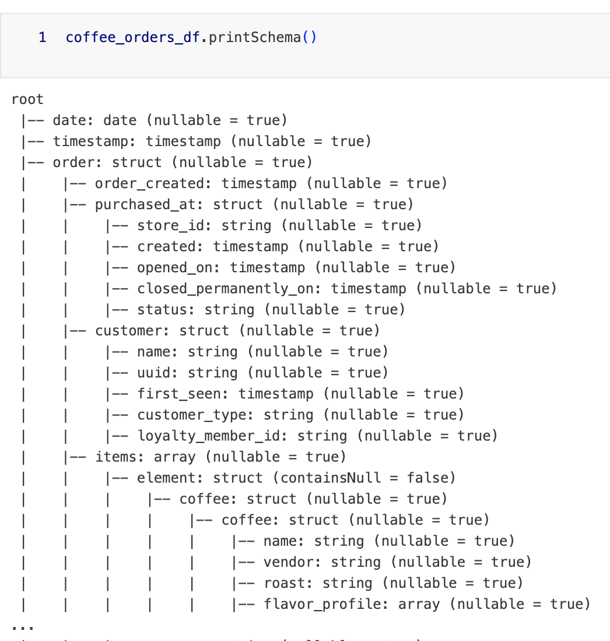
From Tin-X Pattern: Medallion
Lazily Generate Foundational Tables
The Schema is Guaranteed to Match the gRPC Service Definitions
Enabling consistent Foundational Tables from Day 1
Notes:
Protocol + Stream
- Introduction to Protobuf + Buf + Buf Connect
Introduction to Protovalidate for in-flight data validations at the Edge.
Mental Models and Ways of Working (buf breaking…)
How to Utilize Protocol Buffers (aka “protobuf”) for an Unbreakable Data Foundation: How to model consistent and composable serializable structured data to encapsulate entities within our Data Domains through the concept of Messages.
Building Reliable Ingestion Services with gRPC (w/ Buf Connect) and Edge-Level Validation (w/ ProtoValidate): How to successfully build data-dominant ingestion services that include painless field-level validations, that can scale easily, and support the variable requirements for any stage in the lifecycle of any company. (could just talk about protobuf + protovalidate -> hand wave through the connect wizardry (time))
Using Protocol-Streams to Standardize and Simplify ingestion into our internal Data Domains. Apache Kafka, Pulsar, and other distributed message brokers enable distributed data brokerage services utilizing the validated foundational Data Streams emitted from our Ingestion Services. [ share the tin layer (see later) pattern, to aggressively transport our data from (anything else) -> Delta table. Provided that we utilize smart practices when it comes to releasing backwards (non-breaking) changes to the protocol-streams this provides the best foundation for any and all work to begin within the Streaming Lakehouse -> let’s learn about the Streaming Medallion Architecture.
Goals
Config-Driven
Do less but pop up…
Can segue into Brickflow to talk about orchestrating…

Slide 31
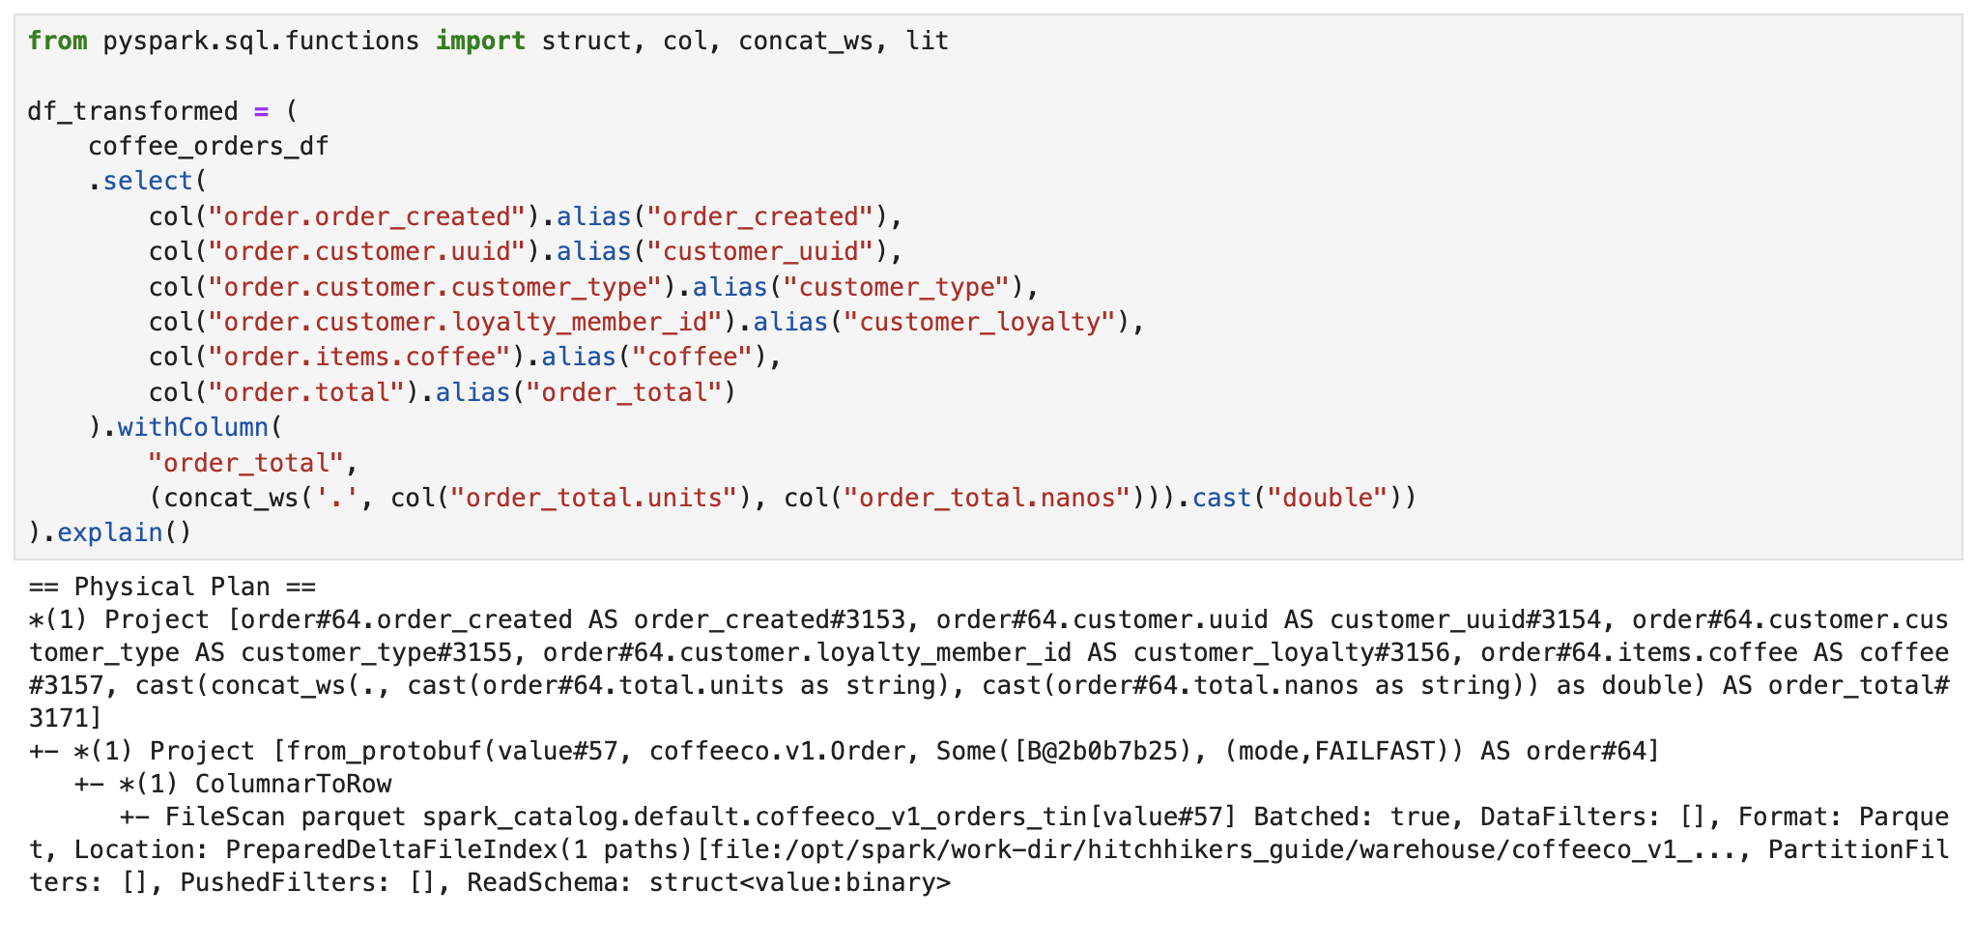
Reliable Transformations
Consistent Extraction from Tin to Bronze
Notes:
Enabling consistent processing of highly-trustworthy protocol streams

Slide 32
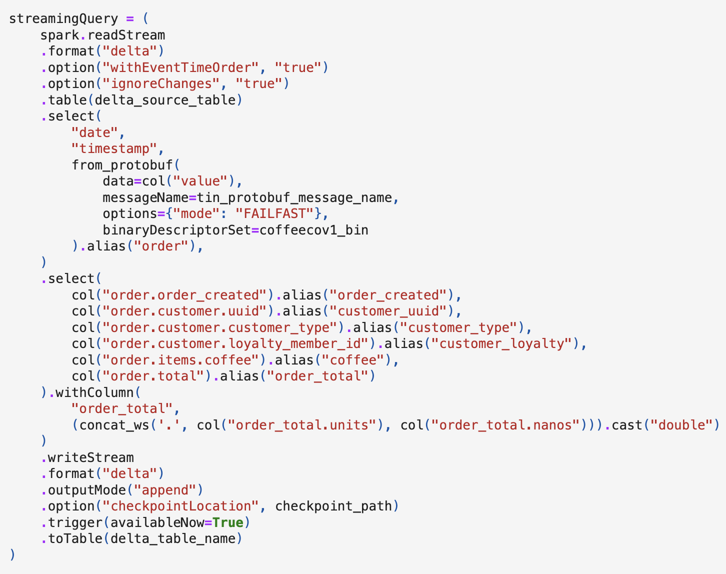
From Tin->X, and X -> Anything
Reliable Foundational Tables
Rely on the Valid Protobuf
Transformations produce consistent tables
Protocol-Driven Development can be achieved
Notes:
Protocol + Stream
- Introduction to Protobuf + Buf + Buf Connect
Introduction to Protovalidate for in-flight data validations at the Edge.
Mental Models and Ways of Working (buf breaking…)
How to Utilize Protocol Buffers (aka “protobuf”) for an Unbreakable Data Foundation: How to model consistent and composable serializable structured data to encapsulate entities within our Data Domains through the concept of Messages.
Building Reliable Ingestion Services with gRPC (w/ Buf Connect) and Edge-Level Validation (w/ ProtoValidate): How to successfully build data-dominant ingestion services that include painless field-level validations, that can scale easily, and support the variable requirements for any stage in the lifecycle of any company. (could just talk about protobuf + protovalidate -> hand wave through the connect wizardry (time))
Using Protocol-Streams to Standardize and Simplify ingestion into our internal Data Domains. Apache Kafka, Pulsar, and other distributed message brokers enable distributed data brokerage services utilizing the validated foundational Data Streams emitted from our Ingestion Services. [ share the tin layer (see later) pattern, to aggressively transport our data from (anything else) -> Delta table. Provided that we utilize smart practices when it comes to releasing backwards (non-breaking) changes to the protocol-streams this provides the best foundation for any and all work to begin within the Streaming Lakehouse -> let’s learn about the Streaming Medallion Architecture.
Goals
Config-Driven
Do less but pop up…
Can segue into Brickflow to talk about orchestrating…

Slide 33
Delivering End to End Trust Networks
Internal Data Domain = (tin + bronze + silver)
External Data Domain
Tin / Landing Zone
Table
Table
Table / View
Streaming Table A
Table
Table
SE
Table
Streaming Table N
Table
Table
Table / View
Table
Bronze + Silver Layers
Gold Layer
Data Application or Process
Notes:
Overview of the Journey: (2-5 minutes)
Add SE for spark-expectations and then get into that for the trust-networks.
Using Brickflow – we can coordinate complex workflows to power the streaming medallion architecture….

Slide 34
Thanks
Feel Free to Reach Out
Scott Haines: https://www.linkedin.com/in/scotthaines/
Source Code
Protobuf: https://bit.ly/dsml-delta
Server-Side/Client-Side: https://bit.ly/dais-highwire
Spark/Delta: https://bit.ly/hitchhikers-guide-to-dls
Available End of November 2024

